Slide 1
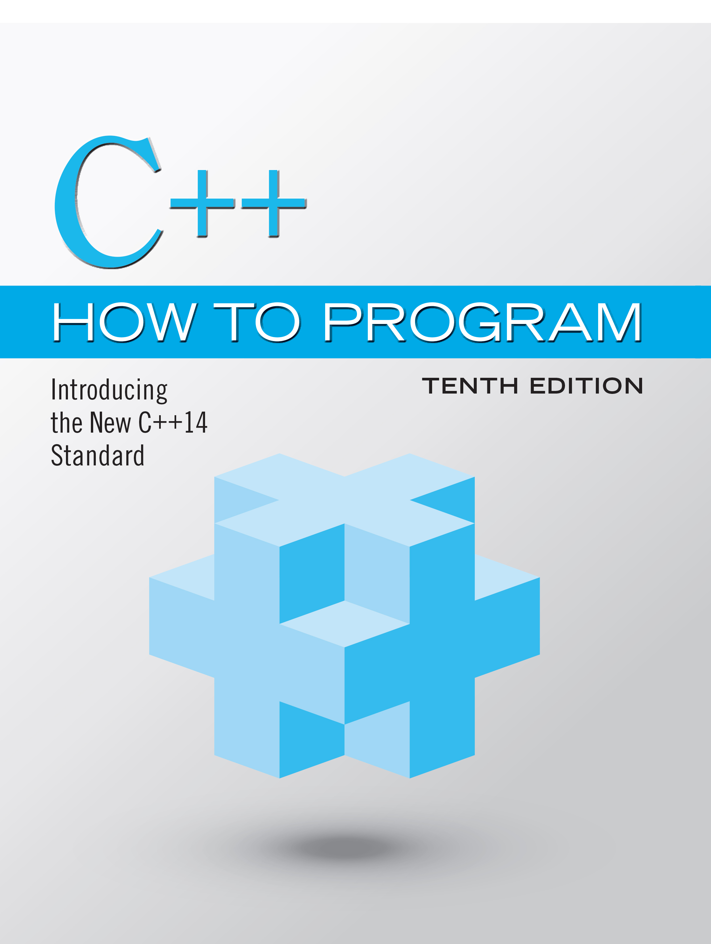
C++ How to Program: Introducing the New C++14 Standard
Tenth Edition
Chapter 11
Object-Oriented Programming: Inheritance
Copyright © 2017, 2014, 2012 Pearson Education, Inc. All Rights Reserved
Notes:
If this PowerPoint presentation contains mathematical equations, you may need to check that your computer has the following installed:
1) MathType Plugin
2) Math Player (free versions available)
3) NVDA Reader (free versions available)

Slide 2
Learning Objectives (1 of 2)
In this chapter you’ll:
11.1 Learn what inheritance is.
11.2 Understand the notions of base classes and derived classes and the relationships between them.
11.3 Use the protected member access specifier.
11.4 Use constructors and destructors in inheritance hierarchies.
11.5 Understand the order in which constructors and destructors are called in inheritance hierarchies.

Slide 3
Learning Objectives (2 of 2)
11.6 Understand the differences between public, protected and private inheritance.
11.7 Use inheritance to customize existing software.

Slide 4
Outline (1 of 2)
11.1 Introduction
11.2 Base Classes and Derived Classes
11.2.1 CommunityMember Class Hierarchy
11.2.2 Shape Class Hierarchy
11.3 Relationship between Base and Derived Classes
11.3.1 Creating and Using a CommissionEmployee Class
11.3.2 Creating a BasePlusCommission-Employee Class Without Using Inheritance
11.3.3 Creating a CommissionEmployee– BasePlusCommissionEmployee Inheritance Hierarchy

Slide 5
Outline (2 of 2)
11.3.4 CommissionEmployee– BasePlusCommissionEmployee Inheritance Hierarchy Using protected Data
11.3.5 CommissionEmployee–BasePlusCommissionEmployee Inheritance Hierarchy Using private Data
11.4 Constructors and Destructors in Derived Classes
11.5 public, protected and private Inheritance
11.6 Wrap-Up

Slide 6
11.1 Introduction (1 of 2)
Inheritance
A form of software reuse in which you create a class that absorbs an existing class’s data and behaviors and enhances them with new capabilities.
You can designate that a new class should inherit the members of an existing class.
This existing class is called the base class, and the new class is referred to as the derived class.
A derived class represents a more specialized group of objects.
C++ offers public, protected and private inheritance.
With public inheritance, every object of a derived class is also an object of that derived class’s base class.

Slide 7
11.1 Introduction (2 of 2)
However, base-class objects are not objects of their derived classes.
With object-oriented programming, you focus on the commonalities among objects in the system rather than on the special cases.
We distinguish between the is-a relationship and the has-a relationship.
The is-a relationship represents inheritance.
In an is-a relationship, an object of a derived class also can be treated as an object of its base class.
By contrast, the has-a relationship represents composition.

Slide 8
11.2 Base Classes and Derived Classes (1 of 2)
Figure 11.1 lists several simple examples of base classes and derived classes.
Base classes tend to be more general and derived classes tend to be more specific.
Because every derived-class object is an object of its base class, and one base class can have many derived classes, the set of objects represented by a base class typically is larger than the set of objects represented by any of its derived classes.
Inheritance relationships form class hierarchies.

Slide 9
11.2 Base Classes and Derived Classes (2 of 2)
A base class exists in a hierarchical relationship with its derived classes.
Although classes can exist independently, once they’re employed in inheritance relationships, they become affiliated with other classes.
A class becomes either a base class—supplying members to other classes, a derived class—inheriting its members from other classes, or both.

Slide 10
Figure 11.1 Inheritance Examples
Base class | Derived classes
Student | GraduateStudent, UndergraduateStudent
Shape | Circle, Triangle, Rectangle, Sphere, Cube
Loan | CarLoan, HomeImprovementLoan, MortgageLoan
Employee | Faculty, Staff
Account | CheckingAccount, SavingsAccount

Slide 11
11.2.1 CommunityMember Class Hierarchy (1 of 3)
Let’s develop a simple inheritance hierarchy with five levels (represented by the U M L class diagram in Figure 11.2).
A university community has thousands of CommunityMembers.
Employees are either Faculty or Staff.
Faculty are either Administrators or Teachers.
Some Administrators, however, are also Teachers.
We’ve used multiple inheritance to form class AdministratorTeacher.

Slide 12
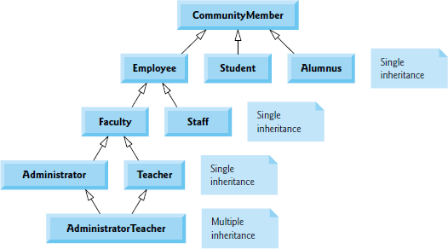
Figure 11.2 Inheritance Hierarchy for University CommunityMembers

Slide 13
11.2.1 CommunityMember Class Hierarchy (2 of 3)
With single inheritance, a class is derived from one base class.
With multiple inheritance, a derived class inherits simultaneously from two or more (possibly unrelated) base classes.

Slide 14
11.2.1 CommunityMember Class Hierarchy (3 of 3)
Each arrow in the hierarchy (Figure 11.2) represents an is-a relationship.
As we follow the arrows in this class hierarchy, we can state “an Employee is a CommunityMember” and “a Teacher is a Faculty member.”
CommunityMember is the direct base class of Employee, Student and Alumnus.
CommunityMember is an indirect base class of all the other classes in the diagram.
Starting from the bottom of the diagram, you can follow the arrows and apply the is-a relationship to the topmost base class.
An AdministratorTeacher is an Administrator, is a Faculty member, is an Employee and is a CommunityMember.

Slide 15
11.2.2 Shape Class Hierarchy
Consider the Shape inheritance hierarchy in Figure 11.3.
Begins with base class Shape.
Classes TwoDimensionalShape and ThreeDimensionalShape derive from base class Shape—Shapes are either TwoDimensionalShapes or Three-DimensionalShapes.
The third level of this hierarchy contains some more specific types of TwoDimensionalShapes and ThreeDimensionalShapes.
As in Figure 11.2, we can follow the arrows from the bottom of the diagram to the topmost base class in this class hierarchy to identify several is-a relationships.

Slide 16
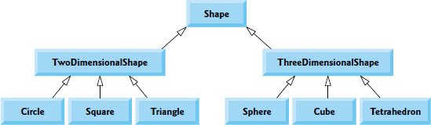
Figure 11.3 Inheritance Hierarchy for Shapes

Slide 17
11.3 Relationship Between Base and Derived Classes
In this section, we use an inheritance hierarchy containing types of employees in a company’s payroll application to discuss the relationship between a base class and a derived class.
Commission employees (who will be represented as objects of a base class) are paid a percentage of their sales, while base-salaried commission employees (who will be represented as objects of a derived class) receive a base salary plus a percentage of their sales.

Slide 18
11.3.1 Creating and Using a CommissionEmployee Class (1 of 3)
CommissionEmployee’s class definition (Figs. 11.4–11.5).
CommissionEmployee’s public services include a constructor and member functions earnings and toString.
Also includes public get and set functions that manipulate the class’s data members firstName, lastName, socialSecurityNumber, grossSales and commissionRate.
private, so objects of other classes cannot directly access this data.
Declaring data members as private and providing non-private get and set functions to manipulate and validate the data members helps enforce good software engineering.

Slide 19
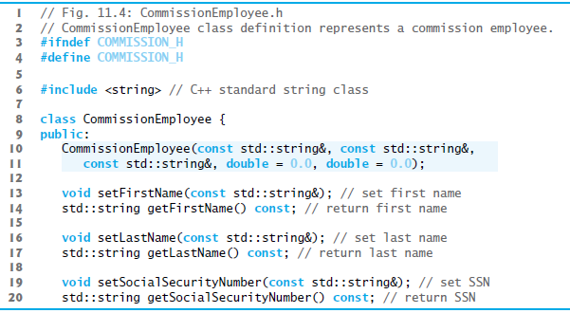
Figure 11.4 CommissionEmployee Class Definition Represents a Commission Employee (1 of 2)

Slide 20
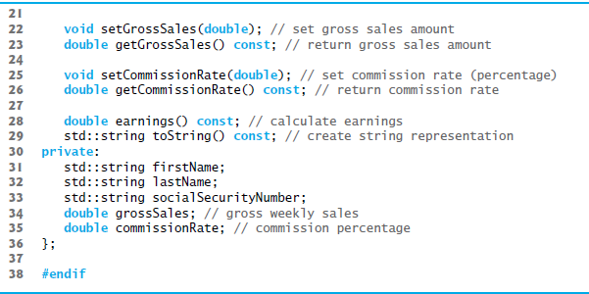
Figure 11.4 CommissionEmployee Class Definition Represents a Commission Employee (2 of 2)

Slide 21
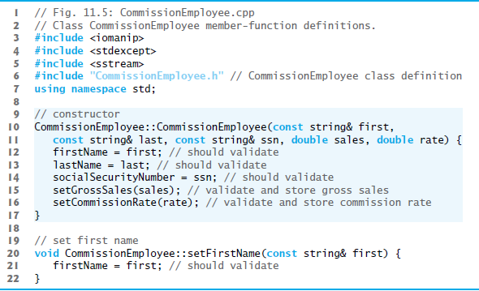
Figure 11.5 Implementation File for CommissionEmployee Class that Represents an Employee Who is Paid a Percentage of Gross Sales (1 of 4)

Slide 22
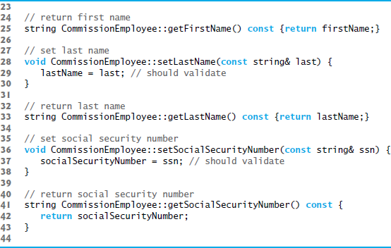
Figure 11.5 Implementation File for CommissionEmployee Class that Represents an Employee Who is Paid a Percentage of Gross Sales (2 of 4)

Slide 23
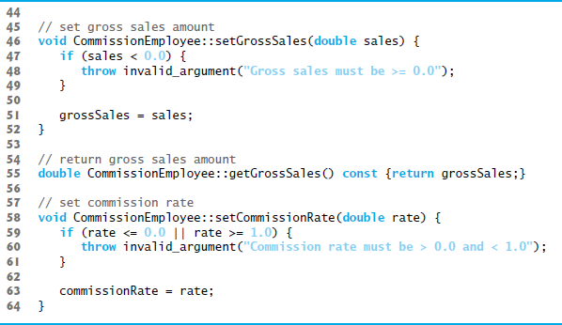
Figure 11.5 Implementation File for CommissionEmployee Class that Represents an Employee Who is Paid a Percentage of Gross Sales (3 of 4)

Slide 24
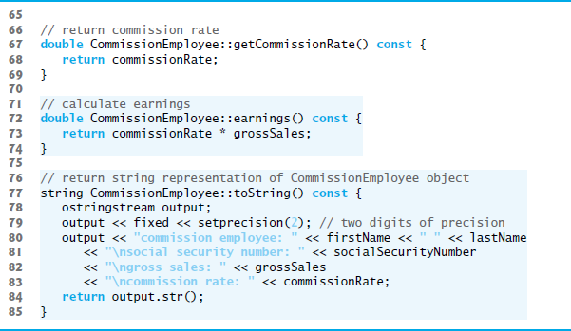
Figure 11.5 Implementation File for CommissionEmployee Class that Represents an Employee Who is Paid a Percentage of Gross Sales (4 of 4)

Slide 25
11.3.1 Creating and Using a CommissionEmployee Class (2 of 3)
CommissionEmployee Constructor
The CommissionEmployee constructor definition purposely does not use member-initializer syntax in the first several examples of this section, so that we can demonstrate how private and protected specifiers affect member access in derived classes.
Later in this section, we’ll return to using member-initializer lists in the constructors.

Slide 26
11.3.1 Creating and Using a CommissionEmployee Class (3 of 3)
CommissionEmployee Member Functions earnings and toString
Member function earnings calculates a CommissionEmployee’s earnings.
Member function toString displays the values of a CommissionEmployee object’s data members.
Testing Class CommissionEmployee
Figure 11.6 tests class CommissionEmployee.

Slide 27
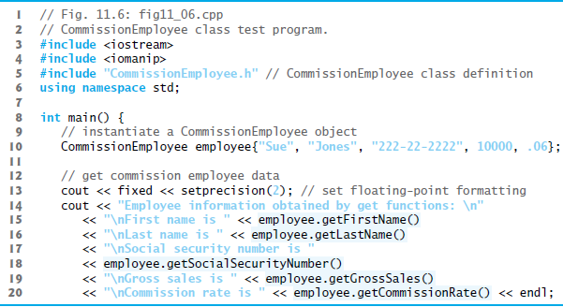
Figure 11.6 CommissionEmployee Class Test Program (1 of 3)

Slide 28
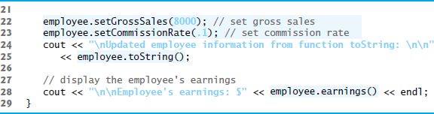
Figure 11.6 CommissionEmployee Class Test Program (2 of 3)

Slide 29
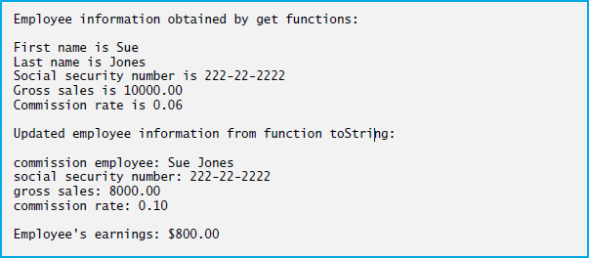
Figure 11.6 CommissionEmployee Class Test Program (3 of 3)

Slide 30
11.3.2 Creating a BasePlusCommissionEmployee Class Without Using Inheritance (1 of 6)
We now discuss the second part of our introduction to inheritance by creating and testing (a completely new and) independent class BasePlusCommissionEmployee (Figs. 11.7–11.8), which contains a first name, last name, social security number, gross sales amount, commission rate and base salary.

Slide 31
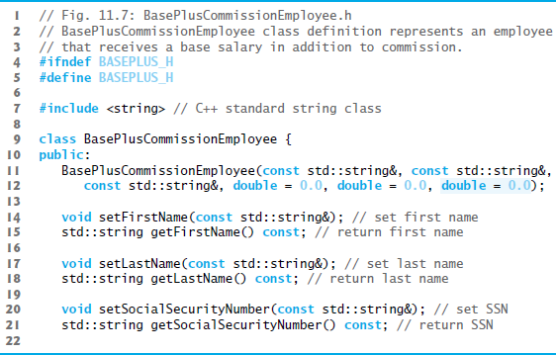
Figure 11.7 BasePlusCommissionEmployee Class Header (1 of 2)

Slide 32
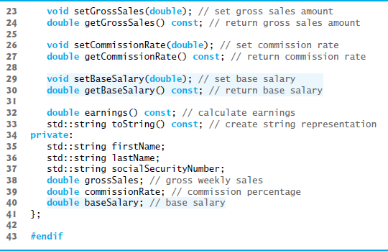
Figure 11.7 BasePlusCommissionEmployee Class Header (2 of 2)

Slide 33
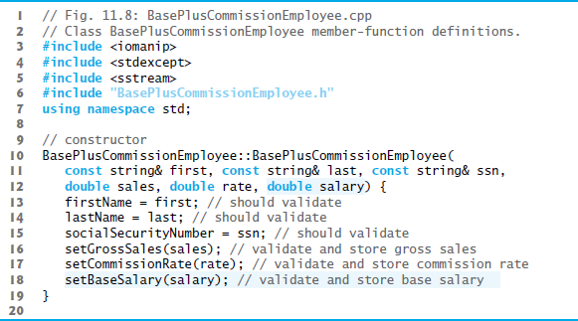
Figure 11.8 BasePlusCommissionEmployee Class Represents an Employee Who Receives a Base Salary in Addition to a Commission (1 of 6)

Slide 34
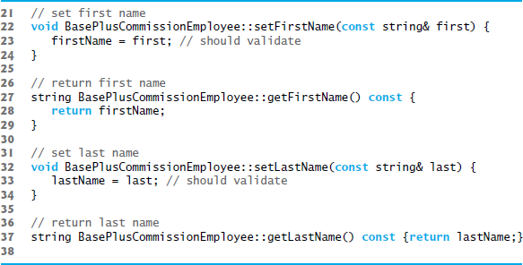
Figure 11.8 BasePlusCommissionEmployee Class Represents an Employee Who Receives a Base Salary in Addition to a Commission (2 of 6)

Slide 35
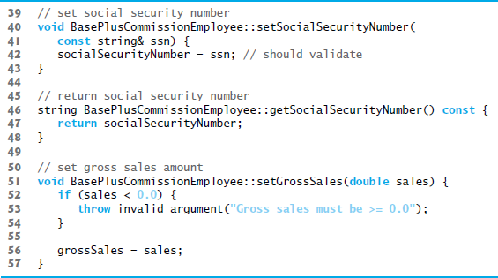
Figure 11.8 BasePlusCommissionEmployee Class Represents an Employee Who Receives a Base Salary in Addition to a Commission (3 of 6)

Slide 36
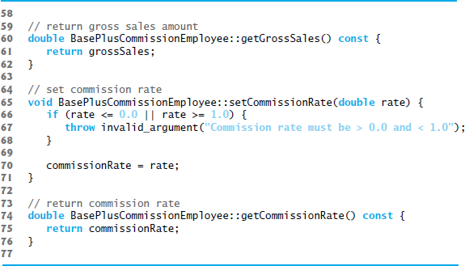
Figure 11.8 BasePlusCommissionEmployee Class Represents an Employee Who Receives a Base Salary in Addition to a Commission (4 of 6)

Slide 37
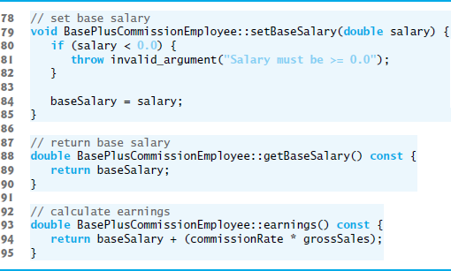
Figure 11.8 BasePlusCommissionEmployee Class Represents an Employee Who Receives a Base Salary in Addition to a Commission (5 of 6)

Slide 38
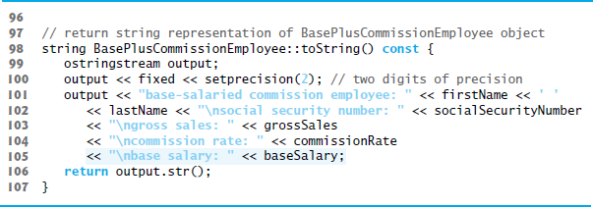
Figure 11.8 BasePlusCommissionEmployee Class Represents an Employee Who Receives a Base Salary in Addition to a Commission (6 of 6)

Slide 39
11.3.2 Creating a BasePlusCommissionEmployee Class Without Using Inheritance (2 of 6)
Defining Class BasePlusCommissionEmployee
The BasePlusCommissionEmployee header (Figure 11.7) specifies class BasePlusCommissionEmployee’s public services, which include the BasePlusCommissionEmployee constructor and member functions earnings and toString.
Lines 14–30 declare public get and set functions for the class’s private data members firstName, lastName, socialSecurityNumber, grossSales, commissionRate and baseSalary.

Slide 40
11.3.2 Creating a BasePlusCommissionEmployee Class Without Using Inheritance (3 of 6)
Note the similarity between this class and class Commission-Employee (Figs. 11.4–11.5)—in this example, we won’t yet exploit that similarity.
Class BasePlusCommissionEmployee’s earnings member function computes the earnings of a base-salaried commission employee.
Testing Class BasePlusCommissionEmployee
Figure 11.9 tests class BasePlusCommissionEmployee.

Slide 41
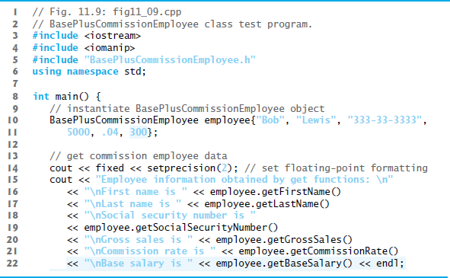
Figure 11.9 BasePlusCommissionEmployee Class Test Program (1 of 3)

Slide 42
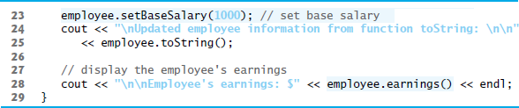
Figure 11.9 BasePlusCommissionEmployee Class Test Program (2 of 3)

Slide 43
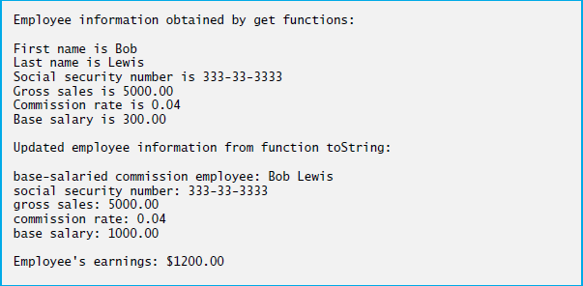
Figure 11.9 BasePlusCommissionEmployee Class Test Program (3 of 3)

Slide 44
11.3.2 Creating a BasePlusCommissionEmployee Class Without Using Inheritance (4 of 6)
Exploring the Similarities Between Class BasePlusCommissionEmployee and Class CommissionEmployee
Most of the code for class BasePlusCommissionEmployee (Figs. 11.7–11.8) is similar, if not identical, to the code for class CommissionEmployee (Figs. 11.4–11.5).
In class BasePlusCommissionEmployee, private data members firstName and lastName and member functions setFirstName, getFirstName, setLastName and getLastName are identical to those of class CommissionEmployee.
Both classes contain private data members socialSecurityNumber, commissionRate and grossSales, as well as get and set functions to manipulate these members.

Slide 45
11.3.2 Creating a BasePlusCommissionEmployee Class Without Using Inheritance (5 of 6)
The BasePlusCommissionEmployee constructor is almost identical to that of class CommissionEmployee, except that BasePlusCommissionEmployee’s constructor also sets the baseSalary.
The other additions to class BasePlusCommissionEmployee are private data member baseSalary and member functions setBaseSalary and getBaseSalary.
Class BasePlusCommissionEmployee’s toString member function is nearly identical to that of class CommissionEmployee, except that BasePlusCommissionEmployee’s toString also outputs the value of data member baseSalary.

Slide 46
11.3.2 Creating a BasePlusCommissionEmployee Class Without Using Inheritance (6 of 6)
We literally copied code from class CommissionEmployee and pasted it into class BasePlusCommissionEmployee, then modified class BasePlusCommissionEmployee to include a base salary and member functions that manipulate the base salary.
This copy-and-paste approach is error prone and time consuming.
Worse yet, it can spread many physical copies of the same code throughout a system, creating a code-maintenance nightmare.

Slide 47
Software Engineering Observation 11.1
Copying and pasting code from one class to another can spread many physical copies of the same code and can spread errors throughout a system, creating a code-maintenance nightmare. To avoid duplicating code (and possibly errors), use inheritance, rather than the “copy-and-paste” approach, in situations where you want one class to “absorb” the data members and member functions of another class.

Slide 48
Software Engineering Observation 11.2
With inheritance, the common data members and member functions of all the classes in the hierarchy are declared in a base class. When changes are required for these common features, you need to make the changes only in the base class—derived classes then inherit the changes. Without inheritance, changes would need to be made to all the source-code files that contain a copy of the code in question.

Slide 49
11.3.3 Creating a CommissionEmployee–BasePlusCommissionEmployee Inheritance Hierarchy (1 of 10)
Now we create and test a new BasePlusCommissionEmployee class (Figs. 11.10–11.11) that derives from CommissionEmployee (Figs. 11.4–11.5).
In this example, a BasePlusCommissionEmployee object is a CommissionEmployee (because inheritance passes on the capabilities of class CommissionEmployee), but class BasePlusCommissionEmployee also has data member baseSalary (Figure 11.10, line 21).

Slide 50
11.3.3 Creating a CommissionEmployee–BasePlusCommissionEmployee Inheritance Hierarchy (2 of 10)
The colon (:) in line 10 of the class definition indicates inheritance.
Keyword public indicates the type of inheritance.
As a derived class (formed with public inheritance), BasePlusCommissionEmployee inherits all the members of class CommissionEmployee, except for the constructor—each class provides its own constructors that are specific to the class.

Slide 51
11.3.3 Creating a CommissionEmployee–BasePlusCommissionEmployee Inheritance Hierarchy (3 of 10)
Destructors, too, are not inherited
Thus, the public services of BasePlusCommissionEmployee include its constructor and the public member functions inherited from class CommissionEmployee—although we cannot see these inherited member functions in BasePlusCommissionEmployee’s source code, they’re nevertheless a part of derived class BasePlusCommissionEmployee.
The derived class’s public services also include member functions setBaseSalary, getBaseSalary, earnings and toString.

Slide 52
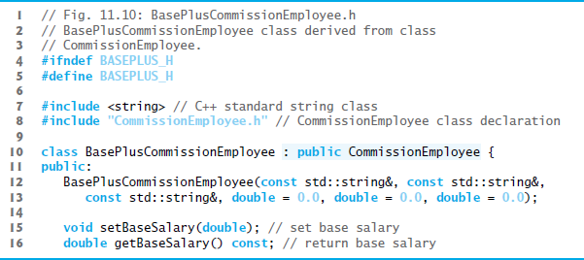
Figure 11.10 BasePlusCommissionEmployee Class Definition Indicating Inheritance Relationship with Class CommissionEmployee (1 of 2)

Slide 53
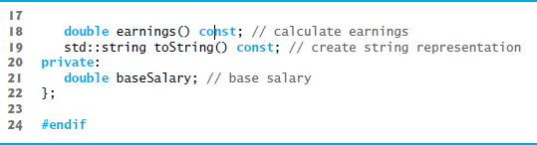
Figure 11.10 BasePlusCommissionEmployee Class Definition Indicating Inheritance Relationship with Class CommissionEmployee (2 of 2)

Slide 54
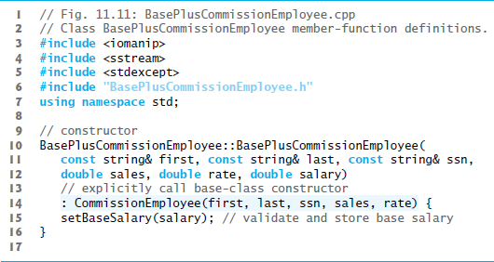
Figure 11.11 BasePlusCommissionEmployee Implementation File: Private Base-Class Data Cannot be Accessed from Derived Class (1 of 4)

Slide 55
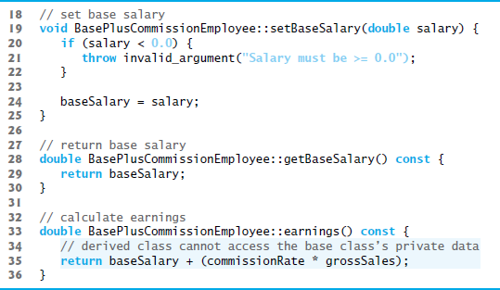
Figure 11.11 BasePlusCommissionEmployee Implementation File: Private Base-Class Data Cannot be Accessed from Derived Class (2 of 4)

Slide 56
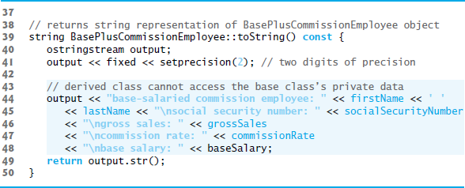
Figure 11.11 BasePlusCommissionEmployee Implementation File: Private Base-Class Data Cannot be Accessed from Derived Class (3 of 4)

Slide 57
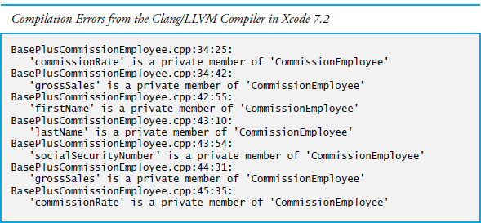
Figure 11.11 BasePlusCommissionEmployee Implementation File: Private Base-Class Data Cannot be Accessed from Derived Class (4 of 4)

Slide 58
11.3.3 Creating a CommissionEmployee–BasePlusCommissionEmployee Inheritance Hierarchy (4 of 10)
Figure 11.11 shows BasePlusCommissionEmployee’s member-function implementations.
The constructor introduces base-class initializer syntax, which uses a member initializer to pass arguments to the base-class constructor.
C++ requires that a derived-class constructor call its base-class constructor to initialize the base-class data members that are inherited into the derived class.
If BasePlusCommissionEmployee’s constructor did not invoke class CommissionEmployee’s constructor explicitly, C++ would attempt to invoke class CommissionEmployee’s default constructor—but the class does not have such a constructor, so the compiler would issue an error.

Slide 59
Common Programming Error 11.1
When a derived-class constructor calls a base-class constructor, the arguments passed to the base-class constructor must be consistent with the number and types of parameters specified in one of the base-class constructors; otherwise, a compilation error occurs.

Slide 60
Performance Tip 11.1
In a derived-class constructor, invoking base-class constructors and initializing member objects explicitly in the member initializer list prevents duplicate initialization in which a default constructor is called, then data members are modified again in the derived-class constructor’s body.

Slide 61
11.3.3 Creating a CommissionEmployee–BasePlusCommissionEmployee Inheritance Hierarchy (5 of 10)
Compilation Errors from Accessing Base-Class private Members
The compiler generates errors for line 35 of Figure 11.11 because base class CommissionEmployee’s data members commissionRate and grossSales are private—derived class BasePlusCommissionEmployee’s member functions are not allowed to access base class CommissionEmployee’s private data.
We used red text in Figure 11.11 to indicate erroneous code.

Slide 62
11.3.3 Creating a CommissionEmployee–BasePlusCommissionEmployee Inheritance Hierarchy (6 of 10)
The compiler issues additional errors in lines 44–47 of BasePlus-Commission-Employee’s toString member function for the same reason.
C++ rigidly enforces restrictions on accessing private data members, so that even a derived class (which is intimately related to its base class) cannot access the base class’s private data.

Slide 63
11.3.3 Creating a CommissionEmployee–BasePlusCommissionEmployee Inheritance Hierarchy (7 of 10)
Preventing the Errors in BasePlusCommissionEmployee
We purposely included the erroneous code in Figure 11.11 to emphasize that a derived class’s member functions cannot access its base class’s private data.
The errors in BasePlusCommissionEmployee could have been prevented by using the get member functions inherited from class CommissionEmployee.

Slide 64
11.3.3 Creating a CommissionEmployee–BasePlusCommissionEmployee Inheritance Hierarchy (8 of 10)
For example, line 37 could have invoked getCommissionRate and getGrossSales to access CommissionEmployee’s private data members commissionRate and grossSales, respectively.
Similarly, lines 44–47 could have used appropriate get member functions to retrieve the values of the base class’s data members.

Slide 65
11.3.3 Creating a CommissionEmployee–BasePlusCommissionEmployee Inheritance Hierarchy (9 of 10)
Including the Base-Class Header in the Derived-Class Header with #include
We #include the base class’s header in the derived class’s header (line 8 of Figure 11.10).
This is necessary for three reasons.
The derived class uses the base class’s name, so we must tell the compiler that the base class exists.
The compiler uses a class definition to determine the size of an object of that class. A client program that creates an object of a class #include the class definition to enable the compiler to reserve the proper amount of memory.
The compiler must determine whether the derived class uses the base class’s inherited members properly.

Slide 66
11.3.3 Creating a CommissionEmployee–BasePlusCommissionEmployee Inheritance Hierarchy (10 of 10)
Linking Process in an Inheritance Hierarchy
In Section 9.3, we discussed the linking process for creating an executable Time application.
The linking process is similar for a program that uses classes in an inheritance hierarchy.
The process requires the object code for all classes used in the program and the object code for the direct and indirect base classes of any derived classes used by the program.
The code is also linked with the object code for any C++ Standard Library classes used.

Slide 67
11.3.4 CommissionEmployee–BasePlusCommissionEmployee Inheritance Hierarchy Using Protected Data (1 of 6)
In this section, we introduce the access specifier protected.
To enable class BasePlusCommissionEmployee to directly access CommissionEmployee data members firstName, lastName, socialSecurityNumber, grossSales and commissionRate, we can declare those members as protected in the base class.
A base class’s protected members can be accessed within the body of that base class, by members and friends of that base class, and by members and friends of any classes derived from that base class.

Slide 68
11.3.4 CommissionEmployee–BasePlusCommissionEmployee Inheritance Hierarchy Using Protected Data (2 of 6)
Defining Base Class CommissionEmployee with protected Data
Class CommissionEmployee (Figure 11.12) now declares data members firstName, lastName, socialSecurityNumber, grossSales and commissionRate as protected (lines 30–35) rather than private.
The member-function implementations are identical to those in Figure 11.5.

Slide 69
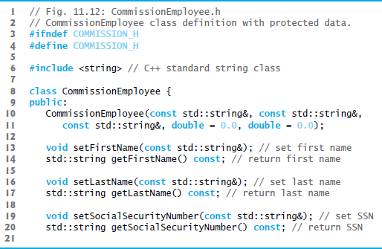
Figure 11.12 CommissionEmployee Class Definition that Declares Protected Data to Allow Access by Derived Classes (1 of 2)

Slide 70
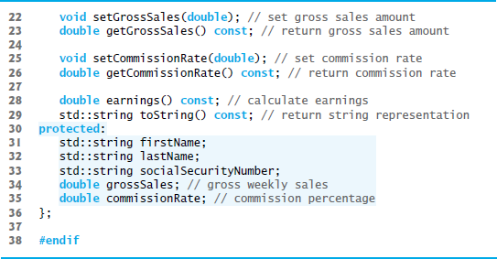
Figure 11.12 CommissionEmployee Class Definition that Declares Protected Data to Allow Access by Derived Classes (2 of 2)

Slide 71
11.3.4 CommissionEmployee–BasePlusCommissionEmployee Inheritance Hierarchy Using Protected Data (3 of 6)
BasePlusCommissionEmployee inherits from class CommissionEmployee in Figure 11.12.
Objects of class BasePlusCommissionEmployee can access inherited data members that are declared protected in class CommissionEmployee (i.e., data members firstName, lastName, socialSecurityNumber, grossSales and commissionRate).
As a result, the compiler does not generate errors when compiling the BasePlusCommissionEmployee earnings and toString member-function definitions in Figure 11.11 (lines 34–38 and 41–49, respectively).
Objects of a derived class also can access protected members in any of that derived class’s indirect base classes.

Slide 72
11.3.4 CommissionEmployee–BasePlusCommissionEmployee Inheritance Hierarchy Using Protected Data (4 of 6)
Testing the Modified BasePlusCommissionEmployee Class
To test the updated class hierarchy, we reused the test program from Figure 11.9.
As shown in Figure 11.13, the output is identical to that of Figure 11.9.
The code for class BasePlusCommissionEmployee is considerably shorter than the code for the noninherited version of the class, because the inherited version absorbs part of its functionality from CommissionEmployee, whereas the noninherited version does not absorb any functionality.
Also, there is now only one copy of the CommissionEmployee functionality declared and defined in class CommissionEmployee.
Makes the source code easier to maintain, modify and debug.

Slide 73
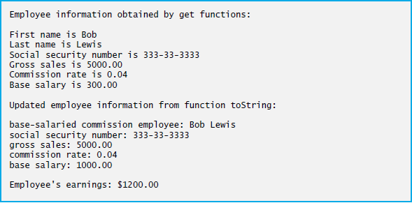
Figure 11.13 Protected Base-Class Data Can be Accessed from Derived Class

Slide 74
11.3.4 CommissionEmployee–BasePlusCommissionEmployee Inheritance Hierarchy Using Protected Data (5 of 6)
Notes on Using protected Data
Inheriting protected data members slightly increases performance, because we can directly access the members without incurring the overhead of calls to set or get member functions.

Slide 75
Software Engineering Observation 11.3
In most cases, it’s better to use private data members to encourage proper software engineering, and leave code optimization issues to the compiler. Your code will be easier to maintain, modify and debug.

Slide 76
11.3.4 CommissionEmployee–BasePlusCommissionEmployee Inheritance Hierarchy Using Protected Data (6 of 6)
Using protected data members creates two serious problems.
The derived-class object does not have to use a member function to set the value of the base class’s protected data member.
Derived-class member functions are more likely to be written so that they depend on the base-class implementation. Derived classes should depend only on the base-class services (i.e., non-private member functions) and not on the base-class implementation.
With protected data members in the base class, if the base-class implementation changes, we may need to modify all derived classes of that base class.
Such software is said to be fragile or brittle, because a small change in the base class can “break” derived-class implementation.

Slide 77
Software Engineering Observation 11.4
It’s appropriate to use the protected access specifier when a base class should provide a service (i.e., a non-private member function) only to its derived classes and friends.

Slide 78
Software Engineering Observation 11.5
Declaring base-class data members private (as opposed to declaring them protected) enables you to change the base-class implementation without having to change derivedclass implementations.

Slide 79
11.3.5 CommissionEmployee–BasePlusCommissionEmployee Inheritance Hierarchy Using Private Data (1 of 5)
We now reexamine our hierarchy once more, this time using the best software engineering practices.
Class CommissionEmployee now declares data members firstName, lastName, socialSecurityNumber, grossSales and commissionRate as private (as shown previously in lines 31–35 of Figure 11.4).

Slide 80
11.3.5 CommissionEmployee–BasePlusCommissionEmployee Inheritance Hierarchy Using Private Data (2 of 5)
Changes to Class CommissionEmployee’s Member Function Definitions
In the CommissionEmployee constructor implementation (Figure 11.14, lines 10–15), we use member initializers (line 12) to set the values of members firstName, lastName and socialSecurityNumber.
Though we do not do so here, derived-class BasePlusCommissionEmployee (Figure 11.15) can invoke non-private base-class member functions (setFirstName, getFirstName, setLastName, getLastName, setSocialSecurityNumber and getSocialSecurityNumber) to manipulate these data members, , as can any client code of class BasePlusCommissionEmployee (such as main).

Slide 81
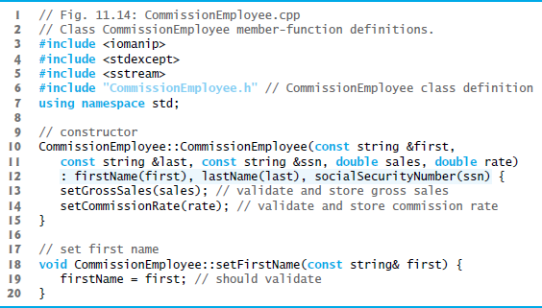
Figure 11.14 CommissionEmployee Class Implementation File: CommissionEmployee Class Uses Member Functions to Manipulate its Private Data (1 of 5)

Slide 82
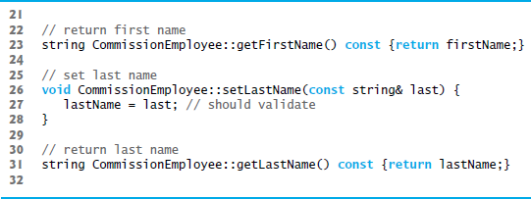
Figure 11.14 CommissionEmployee Class Implementation File: CommissionEmployee Class Uses Member Functions to Manipulate its Private Data (2 of 5)

Slide 83
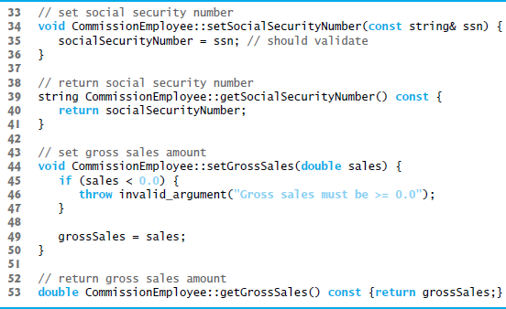
Figure 11.14 CommissionEmployee Class Implementation File: CommissionEmployee Class Uses Member Functions to Manipulate its Private Data (3 of 5)

Slide 84
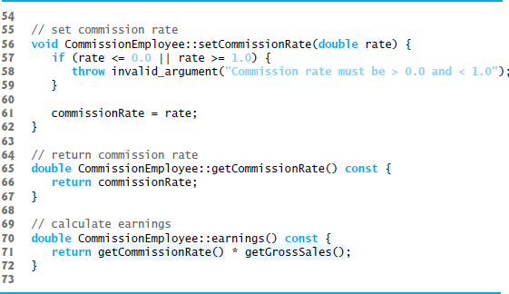
Figure 11.14 CommissionEmployee Class Implementation File: CommissionEmployee Class Uses Member Functions to Manipulate its Private Data (4 of 5)

Slide 85
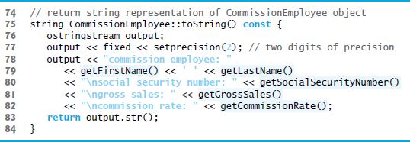
Figure 11.14 CommissionEmployee Class Implementation File: CommissionEmployee Class Uses Member Functions to Manipulate its Private Data (5 of 5)

Slide 86
Performance Tip 11.2
Using a member function to access a data member’s value can be slightly slower than accessing the data directly. However, today’s optimizing compilers perform many optimizations implicitly (such as inlining set and get member-function calls). You should write code that adheres to proper software engineering principles, and leave optimization to the compiler. A good rule is, “Do not second-guess the compiler.”

Slide 87
11.3.5 CommissionEmployee–BasePlusCommissionEmployee Inheritance Hierarchy Using Private Data (3 of 5)
Changes to Class BasePlusCommissionEmployee’s Member Function Definitions
Class BasePlusCommissionEmployee has several changes to its member-function implementations (Figure 11.15) that distinguish it from the previous version of the class (Figs. 11.10–11.11).
Member functions earnings (Figure 11.15, lines 32–34) and toString (lines 37–42) each invoke getBaseSalary to obtain the base salary value.

Slide 88
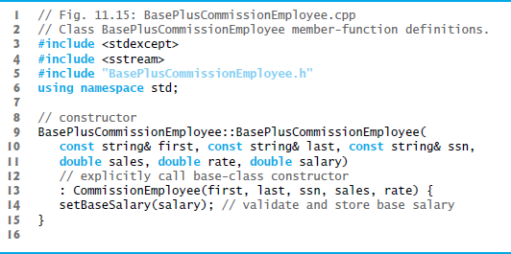
Figure 11.15 BasePlusCommissionEmployee Class that Inherits from Class CommissionEmployee but Cannot Directly Access the Class’s Private Data (1 of 3)

Slide 89
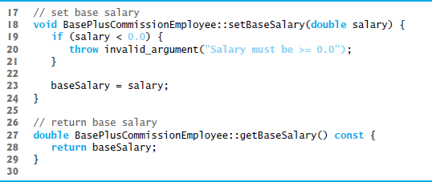
Figure 11.15 BasePlusCommissionEmployee Class that Inherits from Class CommissionEmployee but Cannot Directly Access the Class’s Private Data (2 of 3)

Slide 90
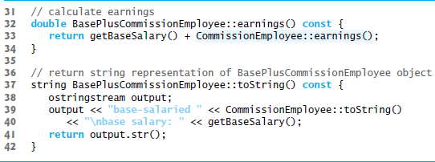
Figure 11.15 BasePlusCommissionEmployee Class that Inherits from Class CommissionEmployee but Cannot Directly Access the Class’s Private Data (3 of 3)

Slide 91
11.3.5 CommissionEmployee–BasePlusCommissionEmployee Inheritance Hierarchy Using private Data (4 of 5)
BasePlusCommissionEmployee Member Function earnings
Class BasePlusCommissionEmployee’s earnings function (Figure 11.15, lines 32–34) redefines class CommissionEmployee’s earnings member function (Figure 11.14, lines 70–72) to calculate the earnings of a base-salaried commission employee. It also calls CommissionEmployee’s earnings function.
Note the syntax used to invoke a redefined base-class member function from a derived class—place the base-class name and the binary scope resolution operator (::) before the base-class member-function name.
Good software engineering practice: If an object’s member function performs the actions needed by another object, we should call that member function rather than duplicating its code body.

Slide 92
Common Programming Error 11.2
When a base-class member function is redefined in a derived class, the derived-class version often calls the base-class version to do additional work. Failure to use the :: operator prefixed with the name of the base class when referencing the base class’s member function causes infinite recursion, because the derived-class member function would then call itself.

Slide 93
11.3.5 CommissionEmployee–BasePlusCommissionEmployee Inheritance Hierarchy Using private Data (5 of 5)
BasePlusCommissionEmployee Member Function toString
BasePlusCommissionEmployee’s toString function (Figure 11.15, lines 37–42) redefines class CommissionEmployee’s toString function (Figure 11.14, lines 75–84) to output the appropriate base-salaried commission employee information.
By using inheritance and by calling member functions that hide the data and ensure consistency, we’ve efficiently and effectively constructed a well-engineered class.

Slide 94
11.4 Constructors and Destructors in Derived Classes (1 of 6)
Instantiating a derived-class object begins a chain of constructor calls in which the derived-class constructor, before performing its own tasks, invokes its direct base class’s constructor either explicitly (via a base-class member initializer) or implicitly (calling the base class’s default constructor).
If the base class is derived from another class, the base-class constructor is required to invoke the constructor of the next class up in the hierarchy, and so on.
The last constructor called in this chain is the constructor of the class at the base of the hierarchy, whose body actually finishes executing first.
The most derived-class constructor’s body finishes executing last.
Each base-class constructor initializes the base-class data members that the derived-class object inherits.

Slide 95
11.4 Constructors and Destructors in Derived Classes (2 of 6)
Instantiating a derived-class object begins a chain of constructor calls in which the derived-class constructor, before performing its own tasks, invokes its direct base class’s constructor either explicitly (via a base-class member initializer) or implicitly (calling the base class’s default constructor).
If the base class is derived from another class, the base-class constructor is required to invoke the constructor of the next class up in the hierarchy, and so on.
The last constructor called in this chain is the constructor of the class at the base of the hierarchy, whose body actually finishes executing first.
The most derived-class constructor’s body finishes executing last.
Each base-class constructor initializes the base-class data members that the derived-class object inherits.

Slide 96
Software Engineering Observation 11.6
When a program creates a derived-class object, the derived-class constructor immediately calls the base-class constructor, the base-class constructor’s body executes, then the derived class’s member initializers execute and finally the derived-class constructor’s body executes. This process cascades up the hierarchy if it contains more than two levels.

Slide 97
11.4 Constructors and Destructors in Derived Classes (3 of 6)
When a derived-class object is destroyed, the program calls that object’s destructor.
This begins a chain (or cascade) of destructor calls in which the derived-class destructor and the destructors of the direct and indirect base classes and the classes’ members execute in reverse of the order in which the constructors executed.
When a derived-class object’s destructor is called, the destructor performs its task, then invokes the destructor of the next base class up the hierarchy.
This process repeats until the destructor of the final base class at the top of the hierarchy is called.
Then the object is removed from memory.

Slide 98
Software Engineering Observation 11.7
Suppose that we create an object of a derived class where both the base class and the derived class contain (via composition) objects of other classes. When an object of that derived class is created, first the constructors for the base class’s member objects execute, then the baseclass constructor body executes, then the constructors for the derived class’s member objects execute, then the derived class’s constructor body executes. Destructors for derived-class objects are called in the reverse of the order in which their corresponding constructors are called.

Slide 99
11.4 Constructors and Destructors in Derived Classes (4 of 6)
Base-class constructors, destructors and overloaded assignment operators (Chapter 10) are not inherited by derived classes.
Derived-class constructors, destructors and overloaded assignment operators, however, can call base-class versions.

Slide 100
11.4 Constructors and Destructors in Derived Classes (5 of 6)
C++11: Inheriting Base Class Constructors
Sometimes a derived class’s constructors simply specify the same parameters as the base class’s constructors.
For such cases, C++11 allows you to specify that a derived class should inherit a base class’s constructors.
To do this explicitly include a using declaration of the following form anywhere in the derived-class definition:
using BaseClass::BaseClass;
In the preceding declaration, BaseClass is the base class’s name.

Slide 101
11.4 Constructors and Destructors in Derived Classes (6 of 6)
When you inherit constructors:
Each inherited constructor has the same access specifier (public, protected or private) as its corresponding base-class constructor.
The default, copy and move constructors are not inherited.
If a constructor is deleted in the base class by placing = delete in its prototype, the corresponding constructor in the derived class is also deleted.
If the derived class does not explicitly define constructors, the compiler still generates a default constructor in the derived class.
A given base-class constructor is not inherited if a constructor that you explicitly define in the derived class has the same parameter list.
A base-class constructor’s default arguments are not inherited. Instead, the compiler generates overloaded constructors in the derived class.

Slide 102
11.5 Public, Protected and Private Inheritance
When deriving a class from a base class, the base class may be inherited through public, protected or private inheritance.
Use of protected and private inheritance is rare.
Figure 11.16 summarizes for each type of inheritance the accessibility of base-class members in a derived class.
The first column contains the base-class access specifiers.
A base class’s private members are never accessible directly from a derived class, but can be accessed through calls to the public and protected members of the base class.

Slide 103
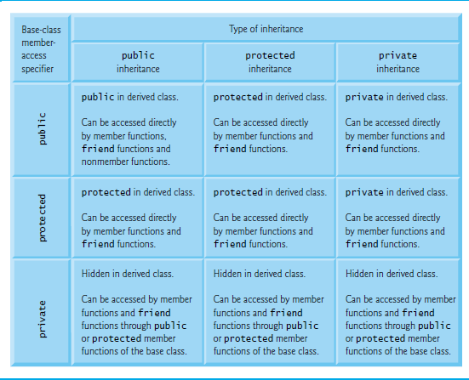
Figure 11.16 Summary of Base-Class Member Accessibility in a Derived Class

Slide 104

Copyright

